Slide 1
Compiler Construction

Slide 2
Chapter 1
Introduction

Slide 3
Definition
A compiler is an executable program that can read a program in one high-level language and translate it into an equivalent executable program in machine language.
program in
high-level
language
Compiler
executable program in machine language
Executable program
in machine language
input
output

Slide 4
Typical Compilation
Compiler
Source program
Target program

Slide 5
The progression of programming languages:
Machine language c7 06 0000 0002
Assembly language mov x 2
High-level language x = 2
*The first compiler was developed by the team at IBM led by John Backus between 1954 and 1957.

Slide 6
Why Take this Course
Reason #1: understand compilers and languages
understand the code structure
understand language semantics
understand relation between source code and generated machine code
become a better programmer

Slide 7
Why Take this Course
Reason #2: nice balance of theory and practice
Theory
  mathematical models: regular expressions, automata, grammars, graphs
  algorithms that use these models
Practice
  Apply theoretical notions to build a real compiler

Slide 8
Why Take this Course
Reason #3: programming experience
write a large program which manipulates complex data structures

Slide 9
Programs Related to Compilers
source program
Interpreters
Assemblers
Linkers
Loaders
Preprocessors
Editors
Debuggers
preprocessor
modified source program
compiler
target assembly program
assembler
relocatable machine code
linker/loader
Library
files
target machine code

Slide 10
Definitions of (translation-related) Languages
    - Source language
    - Target language
- Implementation language

Slide 11
Translator
A program, written in the implementation language, that takes sentences (strings) in the source language and outputs equivalent sentences (strings) in the target language.
e.g. - preprocessor, pretty printer, fortran2c,
pascal2c (high to high)
    - assembler (low to lower)
    - disassembler (lower to low)
- compiler (high to low)

Slide 12
What are the differences between "Interpreter" and "compiler”?
portability
execution speed
with/without object code
with/without optimization
debugging capability

Slide 13
Source Code
int expr( int n )
{
int d;
d = 4*n*n*(n+1)*(n+1);
return d;
}

Slide 14
Source Code
Optimized for human readability
Matches human notions of grammar
Uses named constructs such as variables and procedures

Slide 15
Assembly Code
.globl _expr
_expr:
pushl %ebp
movl %esp,%ebp
subl $24,%esp
movl 8(%ebp),%eax
movl %eax,%edx
leal 0(,%edx,4),%eax
movl %eax,%edx
imull 8(%ebp),%edx
movl 8(%ebp),%eax
incl %eax
imull %eax,%edx
movl 8(%ebp),%eax
incl %eax
imull %eax,%edx
movl %edx,-4(%ebp)
movl -4(%ebp),%edx
movl %edx,%eax
jmp L2
.align 4
L2:
leave
ret
Notes:
compiler: intro

Slide 16
Assembly Code
Optimized for hardware
Consists of machine instructions
Uses registers and unnamed memory locations
Much harder to understand by humans

Slide 17
The Analysis-Synthesis Model of Compilation
    There are two parts to compilation: analysis & synthesis.
    During analysis, the operations implied by the source program are determined and recorded in a hierarchical structure called a tree.
    During synthesis, the operations involved in producing translated code.

Slide 18



The Front-end and Back-end Model of Compilation
Source Intermediate Target
Code Code Code
Front End
Back End

Slide 19
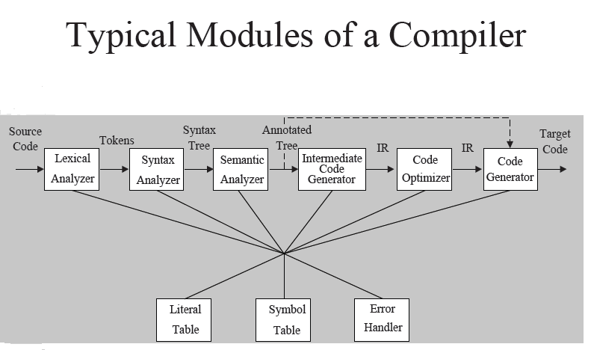
Target code
optimizer

Slide 20
Preprocessor (or Character handler )
throw away the comments
compress multiple blank characters
include files (include nested files)
perform macro expansions (nested macro expansion)
- a macro facility is a text replacement capability
(two aspects: definition & use).
- a macro statement will be expanded into a set of programming language statements or other macro.
compiler option (conditional compilation)
(These jobs may be conducted by lexical analyzer.)

Slide 21
Scanner (Lexical Analyzer)
To identify lexical (word) structure
Input: a stream of chars;
Output: a stream of tokens.
A scanner may also enter identifiers into the symbol table and enter literals into literal table. (literals include numeric constants such as 3.1415926535 and quoted strings such as “Hello, world!”).

Slide 22
An Example: a[index] = 4 + 2 ;
(1) Output of the Scanner :
a ===> identifier
[ ===> left bracket
index ===> identifier
] ===> right bracket
= ===> assignment
===> number
+ ===> plus sign
===> number
; ===> semicolon

Slide 23
How tokens (string of chars) are formed from underlying character set?
Usually specified (described) by sequence of regular expression.
Lexical structures are analyzed via finite state automata.
But it has the look-ahead requirement.
(To recognize a token the scanner may need to look more characters ahead of the token.)

Slide 24
Parser (Syntax Analyzer)
To identify syntax structure
Input: a stream of tokens
Output: On a logical level, some representation of a
parse tree.
Determine how do the tokens fit together to make
up the various syntax entity of a program.
**Most compilers do not generate a parse tree
explicitly but rather go to intermediate code directly as syntax analysis takes place.
Usually specified via context free grammar.
Syntax structures are analyzed by DPDA (Deterministic Push Down Automata)

Slide 25
Predefined context-free grammar
expression → assign-expression
| subscript-expression
| additive-expression
| identifier
| number
assign-expression → expression = expression
subscript-expression → expression [ expression ]
additive-expression → expression + expression

Slide 26
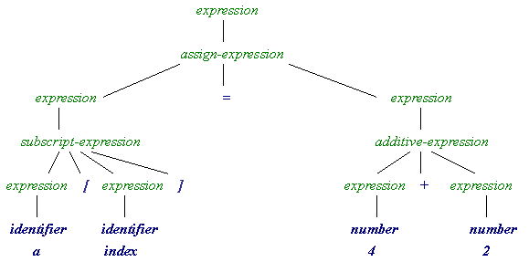
(2) Output of the parser – parse tree (logical level)
structure names
tokens

Slide 27
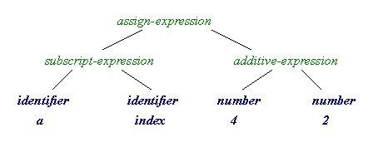
(2)’ Output of the parser – Abstract Syntax Tree (AST)
(condensed parse tree)
=
[]
+

Slide 28
Semantic Analyzer
==> Semantic Structure
- What is the program supposed to do?
- Semantics analysis can be done during syntax analysis phase or intermediate code generator phase or the final code generator.
- typical static semantic features include declarations and type checking.
- information (attributes) gathered can be either added to the tree as annotations or entered into the symbol table.

Slide 29
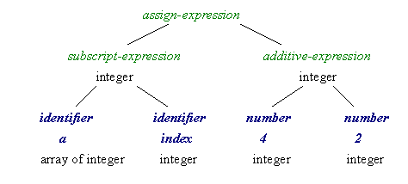
(3) Output of the semantic analyzer – annotated AST
with subscripts from a range

Slide 30
(3) Output of the semantic analyzer (cont’d)
- finds the consistence of data type
among ‘a’, ‘index’, and 2 + 4, or
- declares a type dismatch error if not.

Slide 31
The time ratio for scanning, parsing, and semantic processing is 30:25:45.

Slide 32
Source Code Optimizer

Slide 33
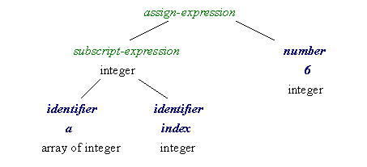
(4) Output of the Source Code Optimizer
with subscripts from a range

Slide 34
Intermediate Code Generator
Transform the parse tree (logical level) into an intermediate language representation, e.g., three address code: A = B op C ( op is a binary operator)
Difference between intermediate code and assembly code:
- Specify the registers to be used for each operation in assembly code.
- Actually intermediate code can be represented as any internal representation such as the syntax tree.

Slide 35
Advanced Code Optimizer
Detection of undefined variables
Detection of loop invariant computation
Constant folding
Removal of induction variables
Elimination of common expression

Slide 36
Elimination of common expression
A = B + C + D
E = B + C + F
might be
T = B + C
A = T + D
E = T + F

Slide 37
Code Generator

Slide 38
(5) Output of the code generator
Mov R0, index // value of index -> R0
Mov R1, &a // address of a -> R1
Add R1, R0 // add R0 to R1
Mov *R1, 6 // constant 6 -> address
in R1

